Slide 1
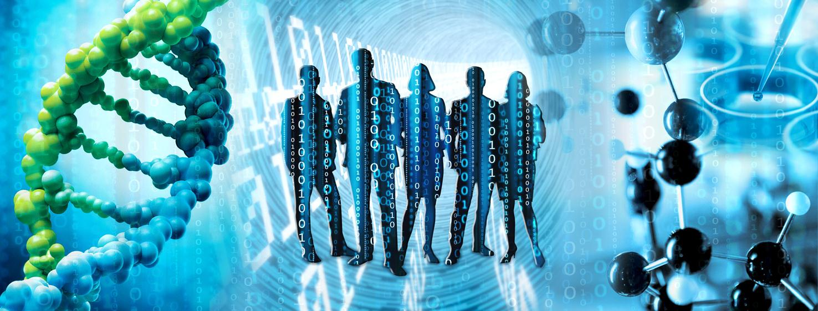
Open Systems Pharmacology (OSP) Workshop
“Introduction to physiologically-based pharmacokinetic modeling with PK-Sim®”
Cleo Demeester, Ibrahim Ince, Jan Schlender
Online training, December 17, 2021

Slide 2
Agenda
13:00-13:10 Welcome and round of introduction
13:10-14:00 Introduction to the Open Systems Pharmacology suite
14:00-15:00 Hands-on I: Setting up a model with PK-Sim
15:00-15:15 Coffee Break
15:15-16:00 Oral drug absorption modeling in PK-Sim
16:00-16:50 Hands-on II: Modeling of absorption and formulation
16:50-17:00 Wrap-up plenary session

Slide 3
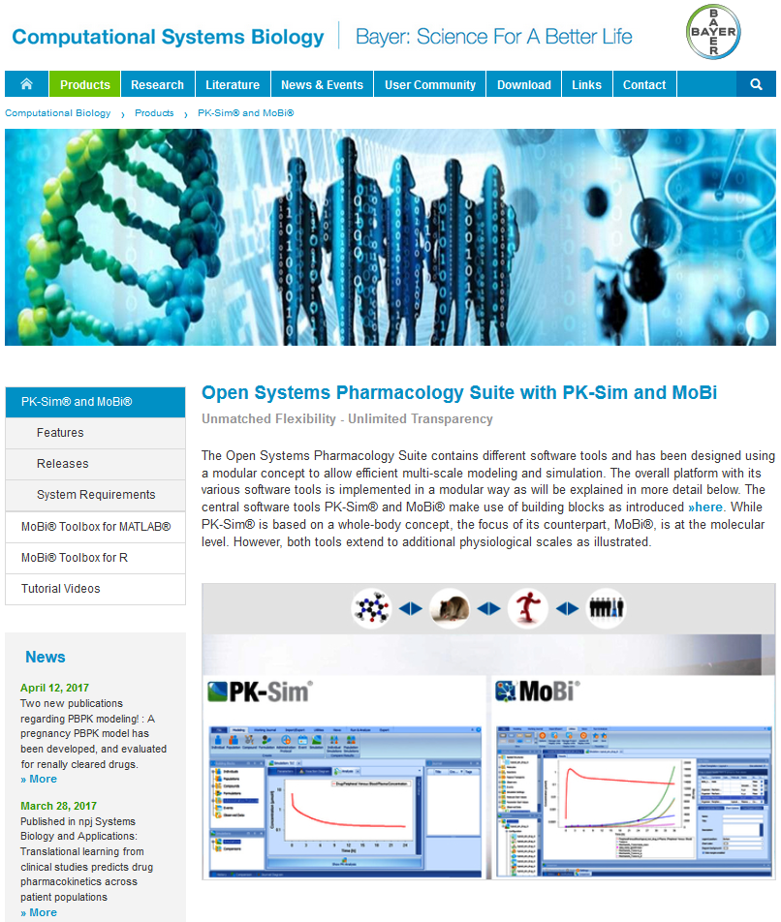
History of Open-Systems-Pharmacology.org
Open Systems Pharmacology Suite
Formerly commercially available software tools PK-Sim®, MoBi® & toolboxes are now open source freeware under GNU Public License v2.0
Fully transparent open source development
Open development of scientific content and qualification approaches
Repositories for open PBPK and Systems Pharmacology models
Join us! Download and use the software! Contribute bug reports, new feature proposals, PBPK & Systems Pharmacology models, code…
… and benefit from contributions of others

Slide 4

Open Systems Pharmacology
Vision
Robust and reliable, easy-to-use modeling & simulation tools, processes and models for pharmaceutical and other life-sciences applications qualified and accepted by a scientific community from academia, regulatory agencies and industry available and open to everyone.
Mission
Provide a platform for joint development, review & qualification, and application of state-of-the-art tools for PBPK and Systems Pharmacology modeling and an open library of models for application as well as method & tool qualification purposes. Promote the idea of pre-competitive open collaboration for the advancement of modeling & simulation sciences in pharmaceutical and life science.

Slide 5
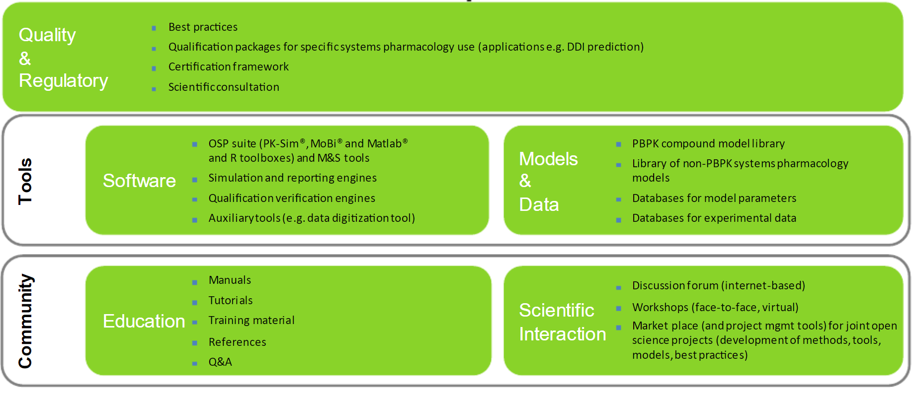
The scope of OSP addresses high priority applications of Systems Pharmacology and the need to continuously develop the scientific, methodological and regulatory foundation together with the software platform
Lippert et al., CPT:PSP (2019)

Slide 6

OSP Management Team coordinates the interplay of focus areas and interfaces between them. Dedicated Focus Groups conceptualize, design and progress the individual areas.
OSP Management Team organize coordination and oversee all activities (bi-weekly meetings)
Rolf Burghaus (Chair), Bayer AG
Andrea Edginton, University of Waterloo
Valvanera Vozmediano Esteban, University of Florida
Andreas Kovar, Sanofi
Thorsten Lehr, Universität des Saarlandes
Jörg Lippert, Bayer AG
José David Gómez Mantilla, Boehringer Ingelheim
Matthew M. Riggs, Metrum Research Group
Stephan Schaller, esqLABS
Michael Sevestre, Design2Code
Erik Sjögren, Pharmetheus, Uppsala University
Juri Solodenko, Bayer AG
Alexander Staab, Boehringer Ingelheim
Donato Teutonico, Sanofi
OSP Sounding Board provides scientific/technical consultancy to MT and informs on trends
Sebastian Frechen, Bayer AG
Mats Karlsson, Uppsala University
Peter Milligan, Pharmetheus
Jan Schlender, Bayer AG
Focus groups are expected to conceptualize and coordinate activities of the respective field.
Includes a OSP MT sponsor, a chair and OSP community members.

Slide 7
Current Focus Groups (1/2)
Focus Group | Objective | Lead (GitHub UserID)
Absorption | The addition of model structures defining additional routes of administration/absorption is required to expand the application scope of the software in a consistent manner across users. The overall objectives are to define processes for Technical generation of new routes of absorption destined for the OSP Suite Evaluation of those absorption modules. | Erik Sjörgren (Erik-Sjogren)
Automation | Automation is a strategic theme of the OSP MT. Automation obviously is a means to increase efficacy but also an enabler the execution large technical tasks like population or trials simulations that cannot be conducted manually. Due to its intrinsic transparency, automation is an element of quality by design. | Juri Solodenko (Yuri05)
Community engagement | To streamline official outside communication channels of OSP Social Media: LinkedIn / Twitter Newsletter / OSP News Section OSP Booth at conferences OSP Events (Hackathon, …) Use Communication Channels to increase community engagement Sustain Community Collaboration Framework | Stephan Schaller (StephanSchaller)
DDI | Quantitative DDI predictions (CYPs as well as transporters) are one of the key applications for PBPK and are a prerequisite for designing efficient clinical development programs and studies. A comprehensive library of well documented, qualified perpetrators and victims is a prerequisite for acceptance of DDI predictions from regulatory authorities. | Sebastian Frechen (sfrechen)
IVIVE | Improve and facilitate use of IVIVE in PK-Sim Provide guidelines on how to conduct IVIVE in PK-Sim Facilitate integration of in vitro data in prediction of DDI (e.g. integration of fraction metabolized) Extrapolation of Caco-2 permeabilities to effective permeabilities | Donato Teutonico (teutonicod)

Slide 8
Current Focus Groups (2/2)
Focus Group | Objective | Lead (GitHub UserID)
PBPK best practices | Establishing Standards for PBPK Model Development and Application to Ensure Reliability, Reproducibility and Transparency, Independent of Modeling Platform. The standards should be considered when developing a PBPK model, regardless of the platform. | Matthew Riggs (riggsmm)
PD | PBPK/PD & QSP modeling is a strategic theme of the OSP MT Identify needs for enabling / facilitating PD/QSP modelling in PK-Sim and MoBi To streamline PD efforts of OSP Derive a strategy for / identify public or industrial collaborations or funding sources to sponsor roadmap implementation | Stephan Schaller (StephanSchaller)
Special populations | The addition of new or updated virtual populations is required to expand the application scope of the software in a consistent manner across users. The overall objectives are to define a process for technical generation of populations destined for the OSP Suite and, evaluation of those populations. This protocol will allow populations to be added more efficiently. | Andrea Edginton (Aedginto)
Statistical Modelling | Statistical Modeling is a strategic theme of the OSP MT. Statistical modeling is a key enabler for PBPK and QSP M&S. Respective capabilities are required for all application areas to quantitatively assess population variability and uncertainty in prior knowledge and posterior results. | Christian Diedrich (DiedrichC)
Suite Release Mgmt. / Software Usability | The software suite is a pillar and the nucleus of OSP. Development and maintenance of the suite is a core element of the OSP mission. Active Release Management is required to execute on this mission. | Juri Solodenko (Yuri05)
Note* Omics and Animal Physiology FGs currently moving through approvals process

Slide 9
Managed Open Source
OSP Suite uses GitHub (https://github.com) as a source control platform
Release planning is realized via the GitHub “Projects” feature. Issues are organized by milestones and effort estimates are proposed and tracked. All of these efforts can be seen by anyone. Release planning and release are only done by the core development team that is supported by industry and academic partners.
Approved “official” releases of the OSP Suite are published on the GitHub Platform and can be downloaded by any user (no GitHub account is required for this). Full release histories are available.
Rigorous software development practices use Continuous Integration (CI) that includes test automation, build automation, code quality analysis and artifact repository. Nightly builds are accessible to anyone and thus always in beta mode for the future version.

Slide 10
www.open-systems-pharmacology.org
Download PK-Sim®, MoBi®, GENEDBhuman, Qualification Framework, R-toolbox
Access source code (if you’re savvy like that)
Find the manuals
Watch/access tutorials
Download models (e.g. bupropion model in PK-Sim, dermal absorption model in Mobi)
View qualification documents (subject of Session #3)
Ask and answer questions on the community FORUM
See the bug reports and fixes (ISSUES in PK-Sim or MoBi)
Notes:
Talk about each tool in first line

Slide 11
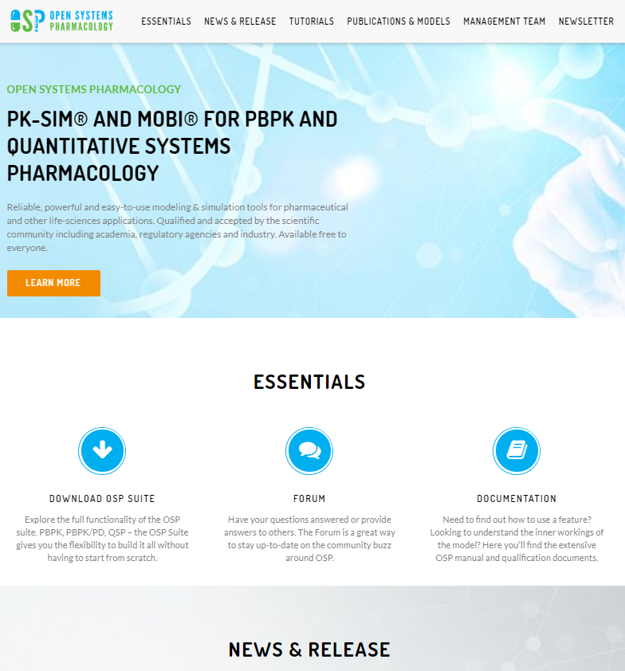

Slide 12
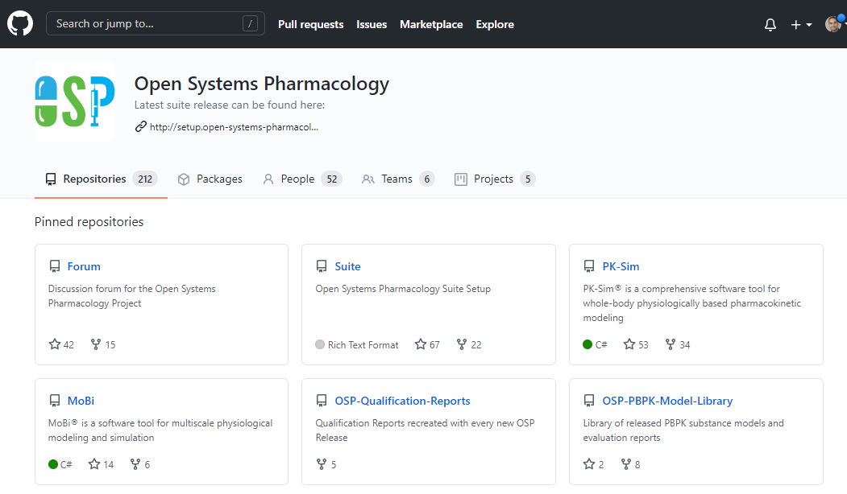
Open-Systems-Pharmacology.org

Slide 13
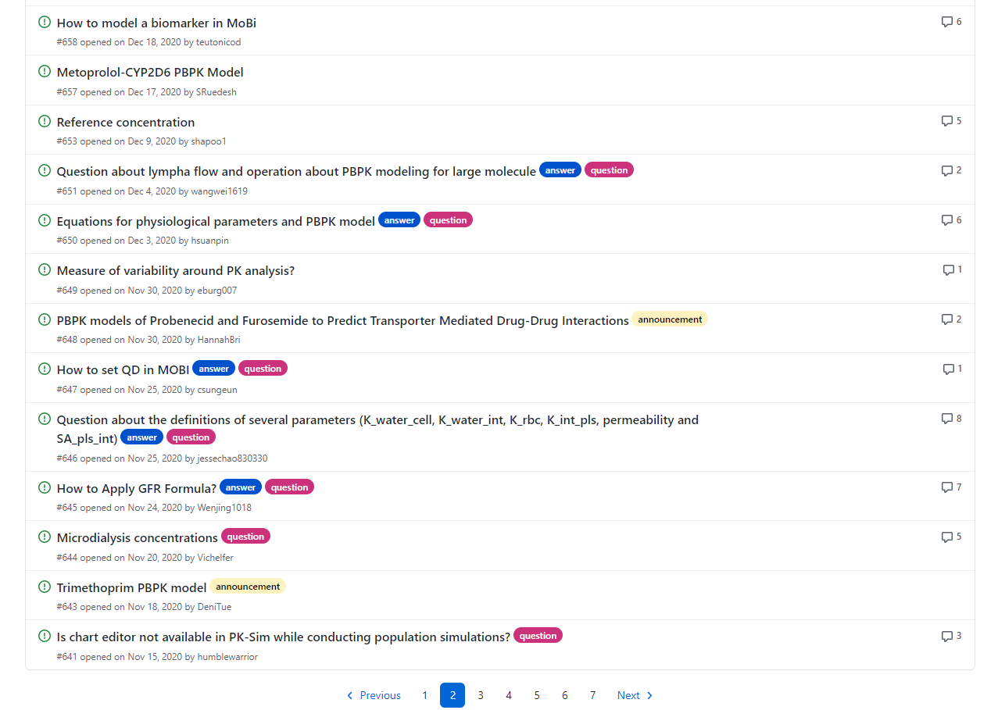

Slide 14
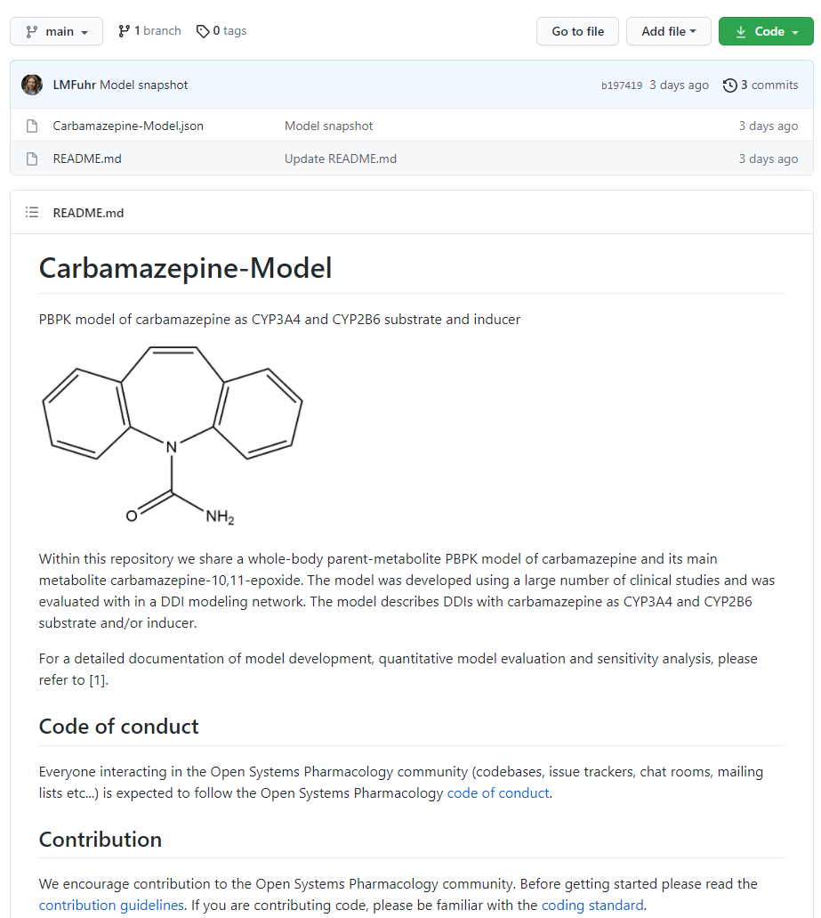

Slide 15
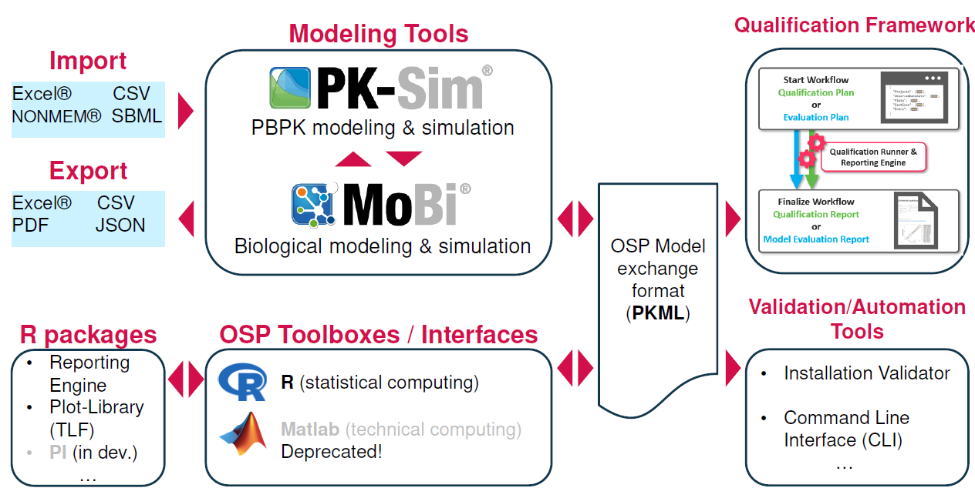
OSP software landscape

Slide 16
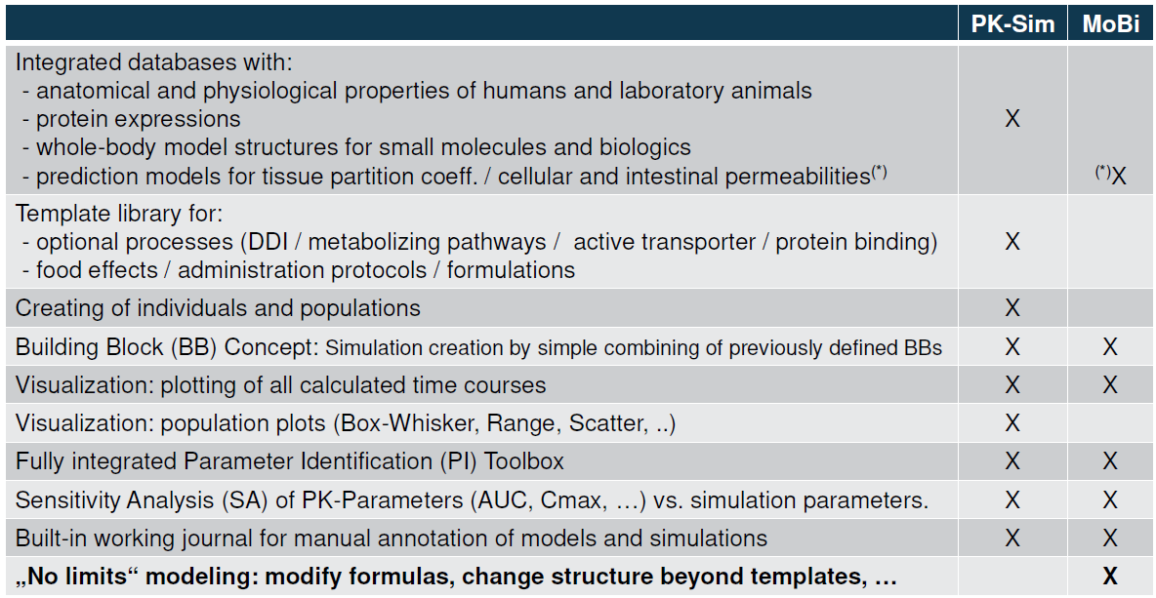
PK-Sim vs. MoBi: main features

Slide 17
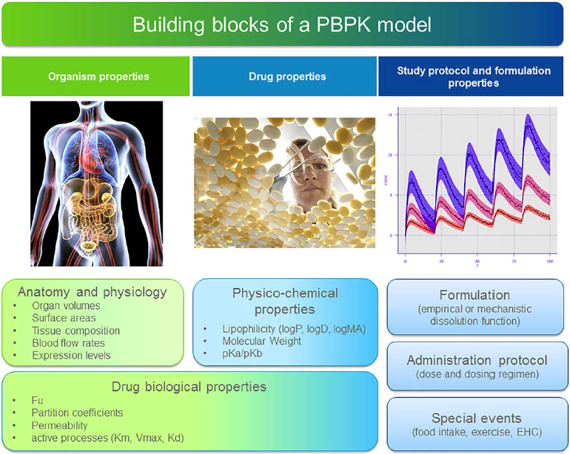
Physiologically-based pharmacokinetic (PBPK) modeling
Simulation = combination of ≥3 building blocks
Extrapolation = exchange of a building block
Input from DMPK
Published information from literature and databases contained in
PK-Sim®
Clinical study protocol, formulation development, etc.
K_{i}, E_{max}, EC₅₀, K_{inact}, K_{I}
Enzymes/transporters involved
Elimination pathways.
Can be calculated using phys-chem and physiology data
Küpfer et al., CPT:PSP (2016)

Slide 18
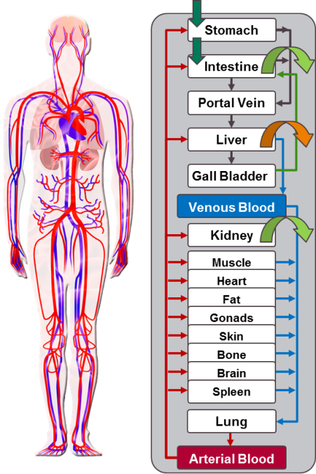
PBPK Model
The Organism is subdivided in compartments
Each compartment represents an organ
For each organ volume, blood-flow and composition are integrated
Mass balance equations for concentrations in tissues (ODEs)

Slide 19
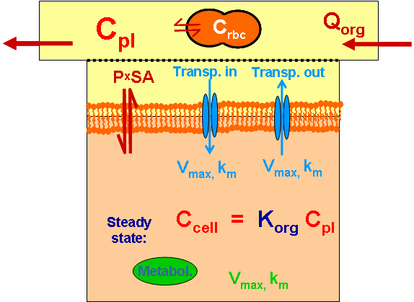
Representation of an Organ in PK-Sim®
Each Organ is divided in sub-compartments:
Cellular Space
Interstitial Space
Vascular space (Plasma and RBC)

Slide 20
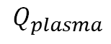
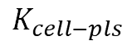
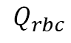
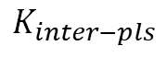
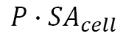
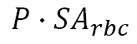
Representation of an Organ in PK-Sim®
$${P∙SA}_{rbc}$$
R
B
C
$$Q_{rbc}$$
$$K_{inter−pls}$$
plasma
$$Q_{plasma}$$
$${P∙SA}_{cell}$$
$$K_{cell−pls}$$
interstitial
intracellular

Slide 21
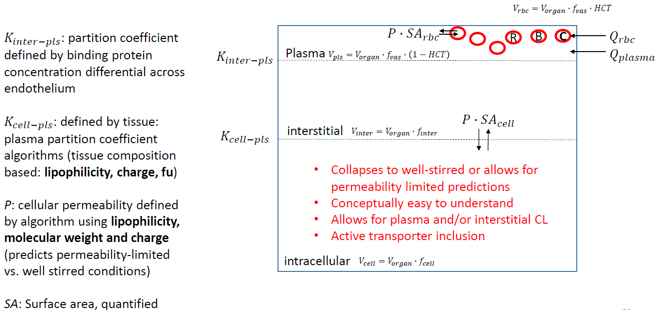
Representation of an Organ in PK-Sim®
P x SA >> Q_{org}
Equilibrium is reached rapidly. Concentration is well mixed and equal throughout the interstitial- and intracellular space
“well-stirred”
P x SA << Q_{org}
Uptake in the intracellular space is the rate-determining
not “well-stirred”

Slide 22
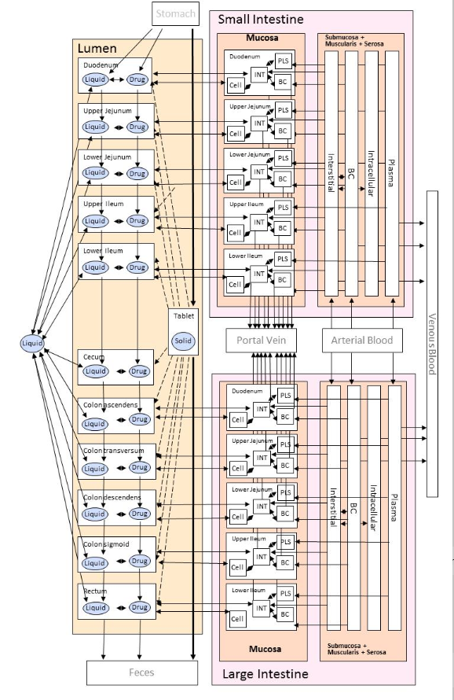
PBPK Model Gastro-intestinal (GI) Tract
12 compartments representing the lumen of the GI tract from stomach to rectum
Varying properties:
Dimensions
pH values
absorptive surface area
transit times
11 compartments representing the intestinal mucosa which is (subdivided into enterocytes, interstitial and vascular space)
Explicit representation of intestinal mucosa allows to account for
CYP distribution
transporter distribution
Thelen et al. J Pharm Sci. (2011)

Slide 23
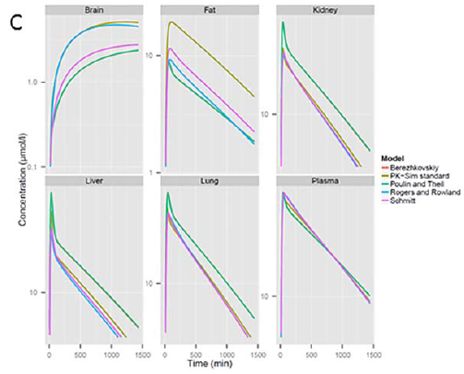
PBPK Model – Distribution
Five different methods available for the calculation of the organ-plasma-partition coefficient:
PK-Sim® Standard
Poulin & Theil
Berezhkovskiy
Rodgers & Rowland
Schmitt Model
neutral compounds
polar compounds
General approach for distribution models:
Tissue (cells + interstitium), plasma, and blood are described as an aqueous and one/more organic subcompartments (lipids/proteins)
Equilibrium organ-plasma-partition coefficients are calculated
Küpfer et al., CPT:PSP (2016)

Slide 24

Population Generation
One dose does not fit all
It is equally important to consider the variability in PK as well as the mean profile when designing dosage regimens or performing a risk assessment
With Population PBPK modeling we can understand and predict inter-individual variability in PK as a composite output of inter-individual variability in key input parameters

Slide 25
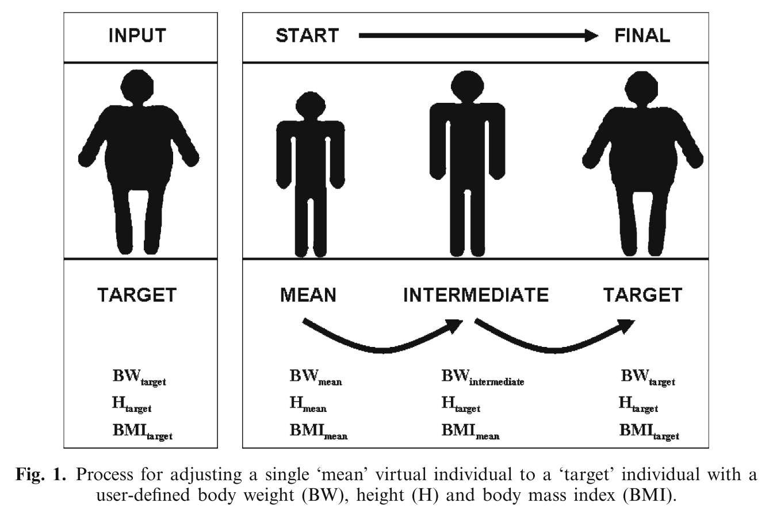
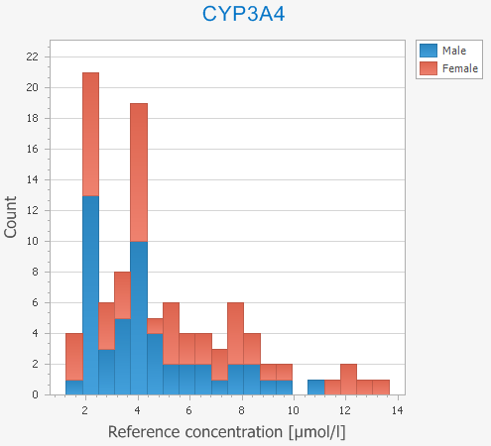
Population Generation
Primary parameters have anthropometric variability incorporated by default in the OSP suite
If not already pre-defined in the database, variability in secondary parameters must be specified with a mean and SD (normal distribution) or geoSD (lognormal distribution)
Willmann S, et al. (2007) Journal of pharmacokinetics and pharmacodynamics 34 (3):401-431.

Slide 26
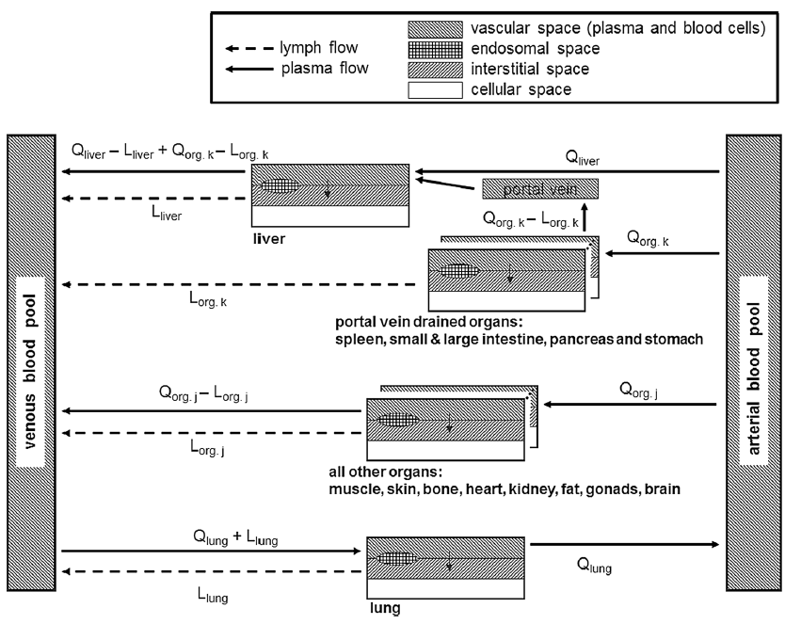




PBPK model for therapeutic proteins in PKSim
For the PBPK model for proteins, an additional compartment needs to be added for each organ representing the endosomes and lysosomes within vascular endothelial
In this endosomal space compartment, lysosomal degradation and high affinity FcRn binding is located
Organ-specific lymph flow is integrated into the model for protein therapeutics connecting the interstitial space of each organ to the venous blood pool
Extravasation by the two-pore model
The PBPK model is developed and evaluated with compounds of different size and affinity to FcRn
Niederalt et al. J Pharmacokinet Pharmacodyn. (2018)

Slide 27
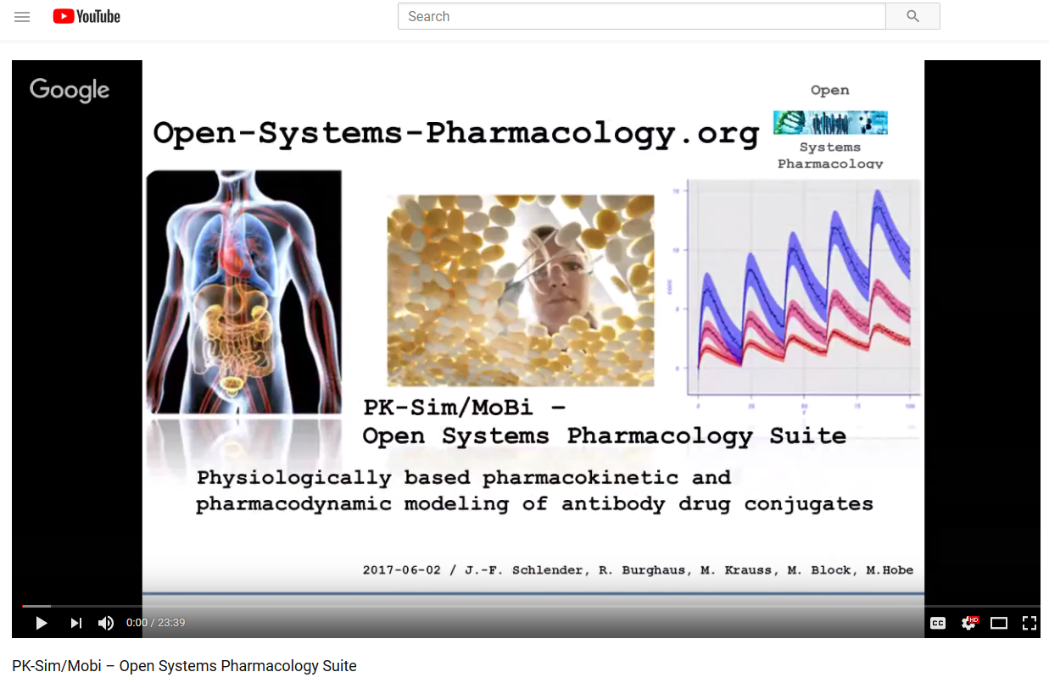
PBPK models of large molecules
Further training material available on:
https://github.com/Open-Systems-Pharmacology/ISOP-webinar---PK-Sim-MoBi-introduction

Slide 28
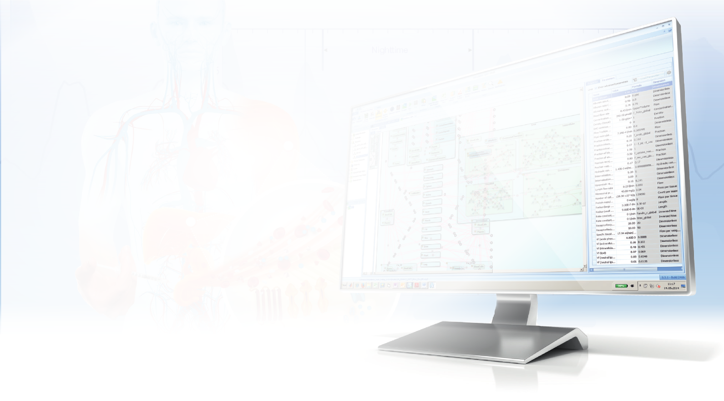
Hands-on:
Build a PBPK model:
Ciprofloxacin as a case example

Slide 29
Hands-on Exercise: Build a PBPK model
Background
Ciprofloxacin
Liver Elimination
Renal Elimination
(60-70%)
CYP1A2 metabolism
Biliary clearance

Slide 30
Hands-on Exercise: Build a PBPK model
Objectives
Use literature values in the model and compare predictions to data.
Start with the file “PBPK_1.pksim5”
All needed building blocks are already available in the PK-Sim file
Create a simulation called “IV_1” and select the following options:
Partition coefficient → PK-Sim standard
Cellular Permeabilities → PK-Sim standard
Lipophilicity → “Measurement from Drug Bank”
Specific Intestinal Permeability → Calculated
Check that CYP1A2, GFR and Biliary secretion processes are selected
Choose the administration Davis 200 iv
Run the simulation and drag-and-drop the data on the plot
Compare the Observed Data with your Simulation Results!

Slide 31
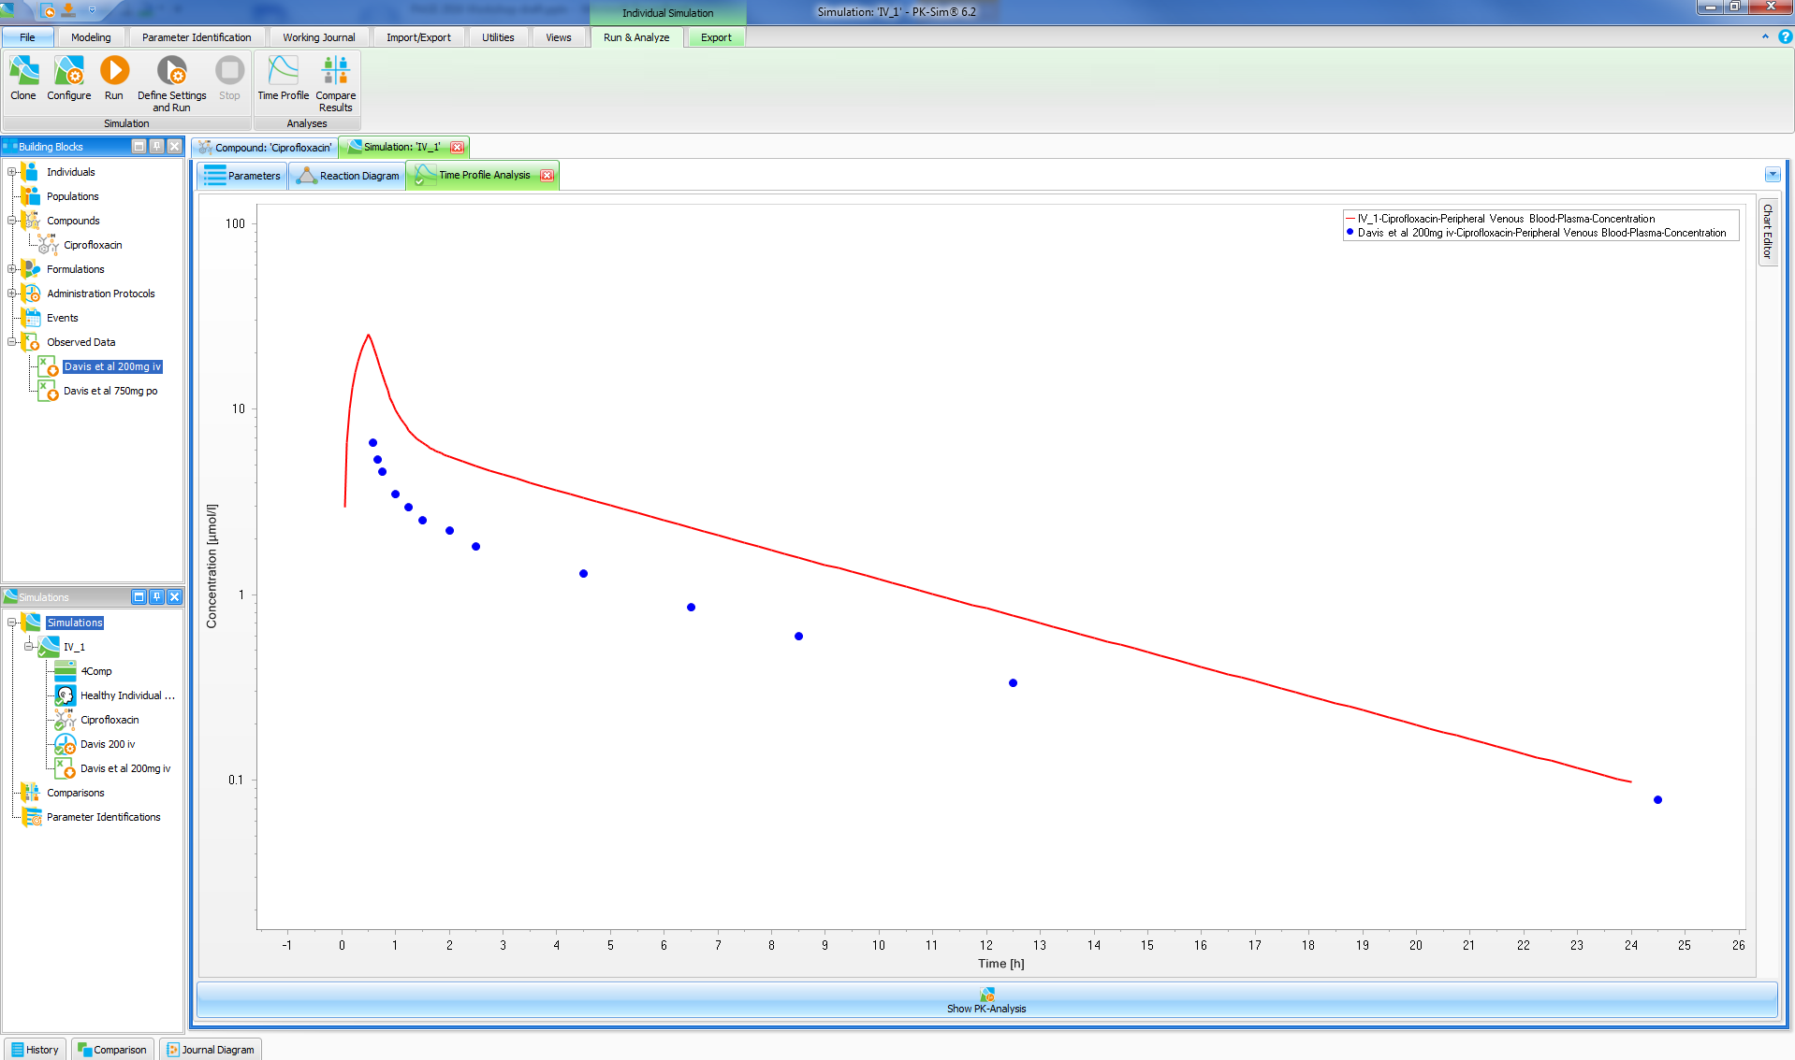
Hands-on Exercise: Build a PBPK model (you can start from this point with file “PBPK_2.pksim5”)

Slide 32
Hands-on Exercise: Build a PBPK model
Objectives
Optimize the Lipophilicity value. Start with the file “PBPK_2.pksim5”
Optional: Add lipophilicity to your Favorites parameters
Clone the simulation IV_1 and rename it IV_2. Select lipophilicity parameter named “Optimized lipo”
Right click on the simulation IV_2 and select “Start parameter identification”
Verify that the data and the parameter section are correctly configured.
Run the parameter identification
Select the tab “Results” and import the new parameter in the simulation and run it again.
Compare the Observed Data with your Simulation Results!

Slide 33
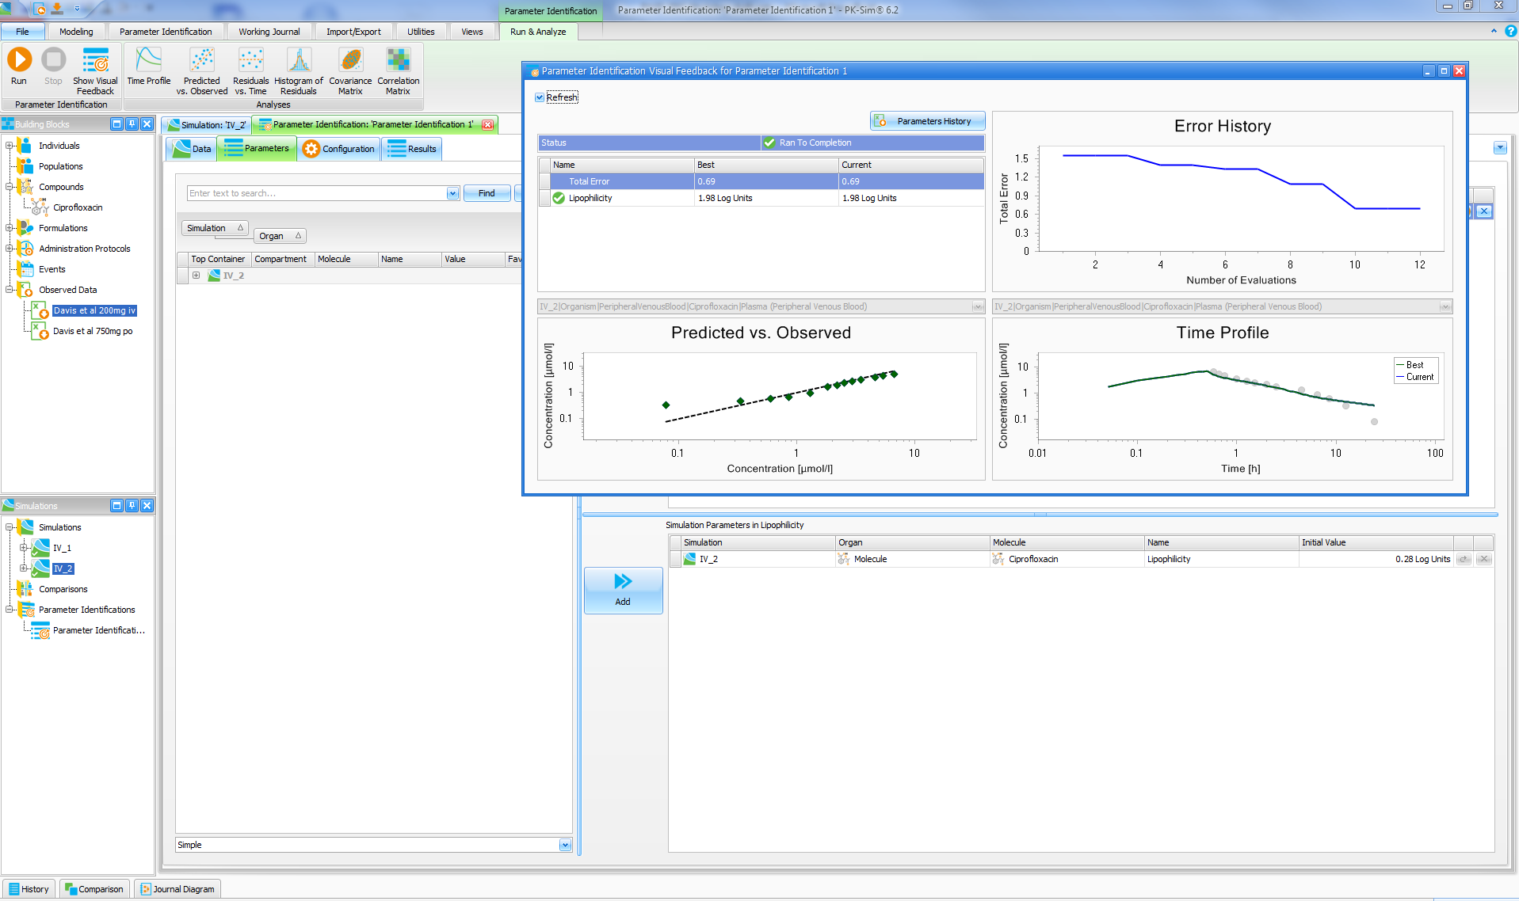
Hands-on Exercise: Build a PBPK model (you can start from this point with file “PBPK_3.pksim5”)

Slide 34
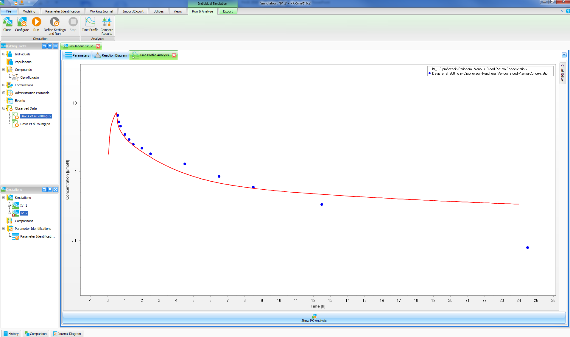
Hands-on Exercise: Build a PBPK model (you can start from this point with file “PBPK_3.pksim5”)

Slide 35
Hands-on Exercise: Build a PBPK model
Objectives
Compare renal excretion to data and estimate tubular secretion and lipophilicity.
Start with the file “PBPK_3.pksim5”
Select “Define settings and run” and add the output “Kidney | Urine | Fraction excreted” and run the simulation. Select the output from the chart editor.
Renal excretion is approx. 15%, while we know from literature it should be 60-70% for IV administration.
Clone the simulation “IV_1” and name the clones simulation “IV_3”, select lipophilicity parameter named “Optimized lipo” and select the renal clearance in the Processes tab. Then click OK.
Select the new added parameter as Favorites
Start a new parameter identification by right-click on the simulation
Set the boundaries of the renal clearance parameter between 0 and 100 and run the optimization.
Import the parameters in the simulation and compare the simulation with the data, including fraction excreted in the urine.

Slide 36
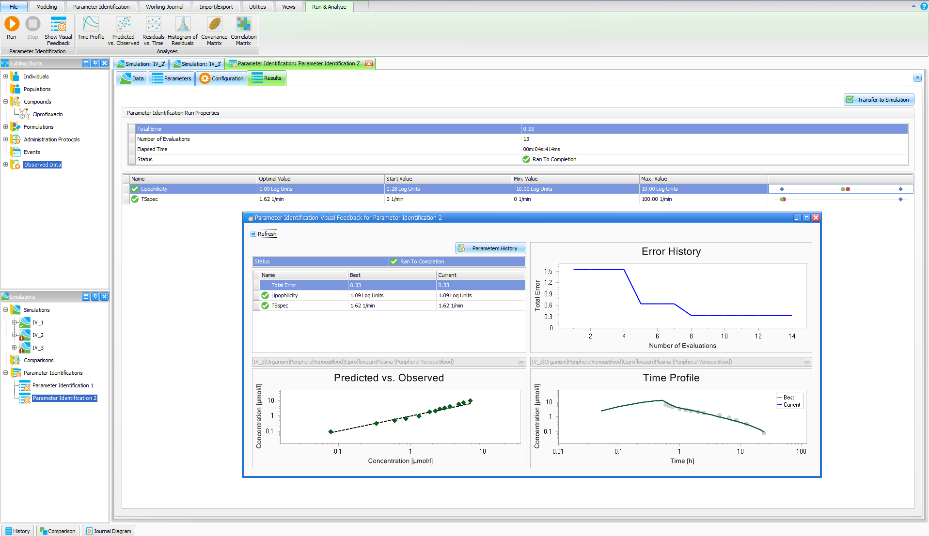
Hands-on Exercise: Build a PBPK model (you can start from this point with file “PBPK_4.pksim5”)

Slide 37
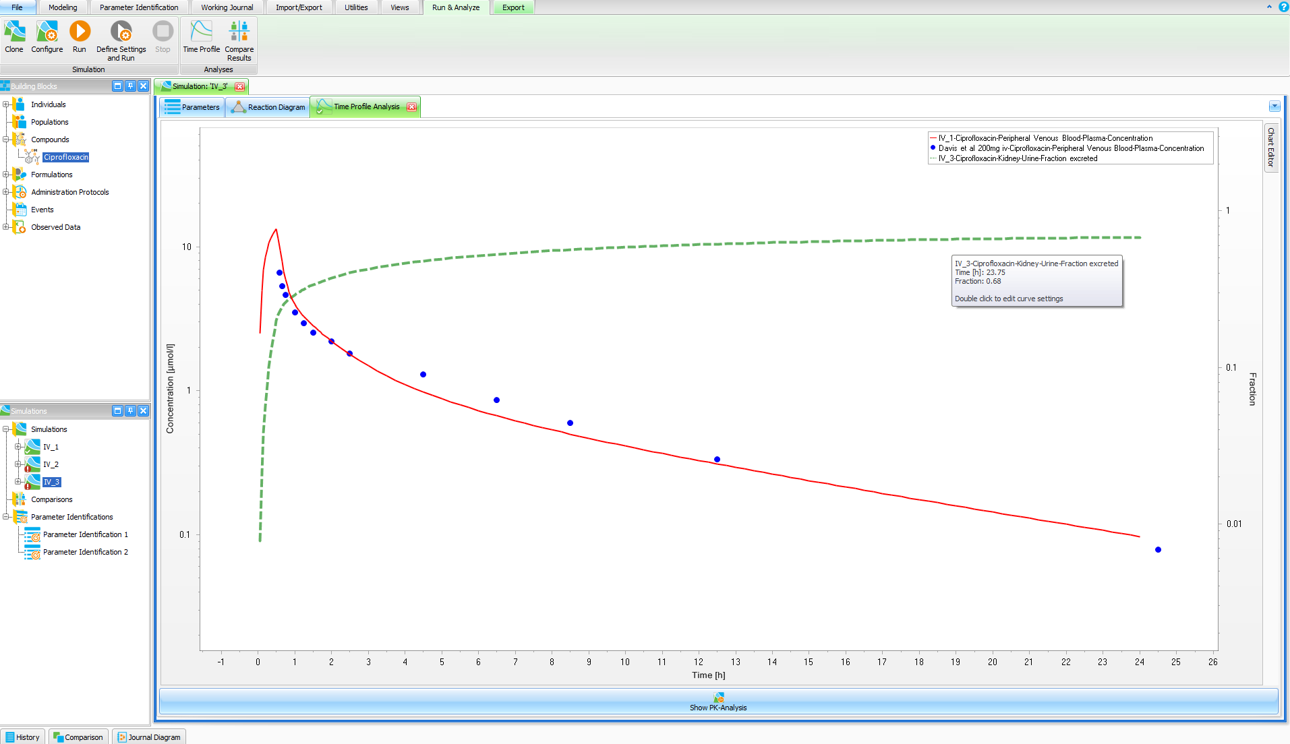
Hands-on Exercise: Build a PBPK model (you can start from this point with file “PBPK_4.pksim5”)

Slide 38
Hands-on Exercise: Build a PBPK model
Objectives
Build an oral model from the IV model just built.
Start with the file “PBPK_4.pksim5”
Commit the new estimated parameter in the Compound building block by right click on the compound in the simulation IV_3
Clone simulation IV_3 and rename it Oral_1. In the administration section select Davis 750 po and click OK.
Delete the IV data in the cloned simulation by right click on the data in the simulation and run the simulation
Drug and drop the oral data and compare the predictions to the data

Slide 39
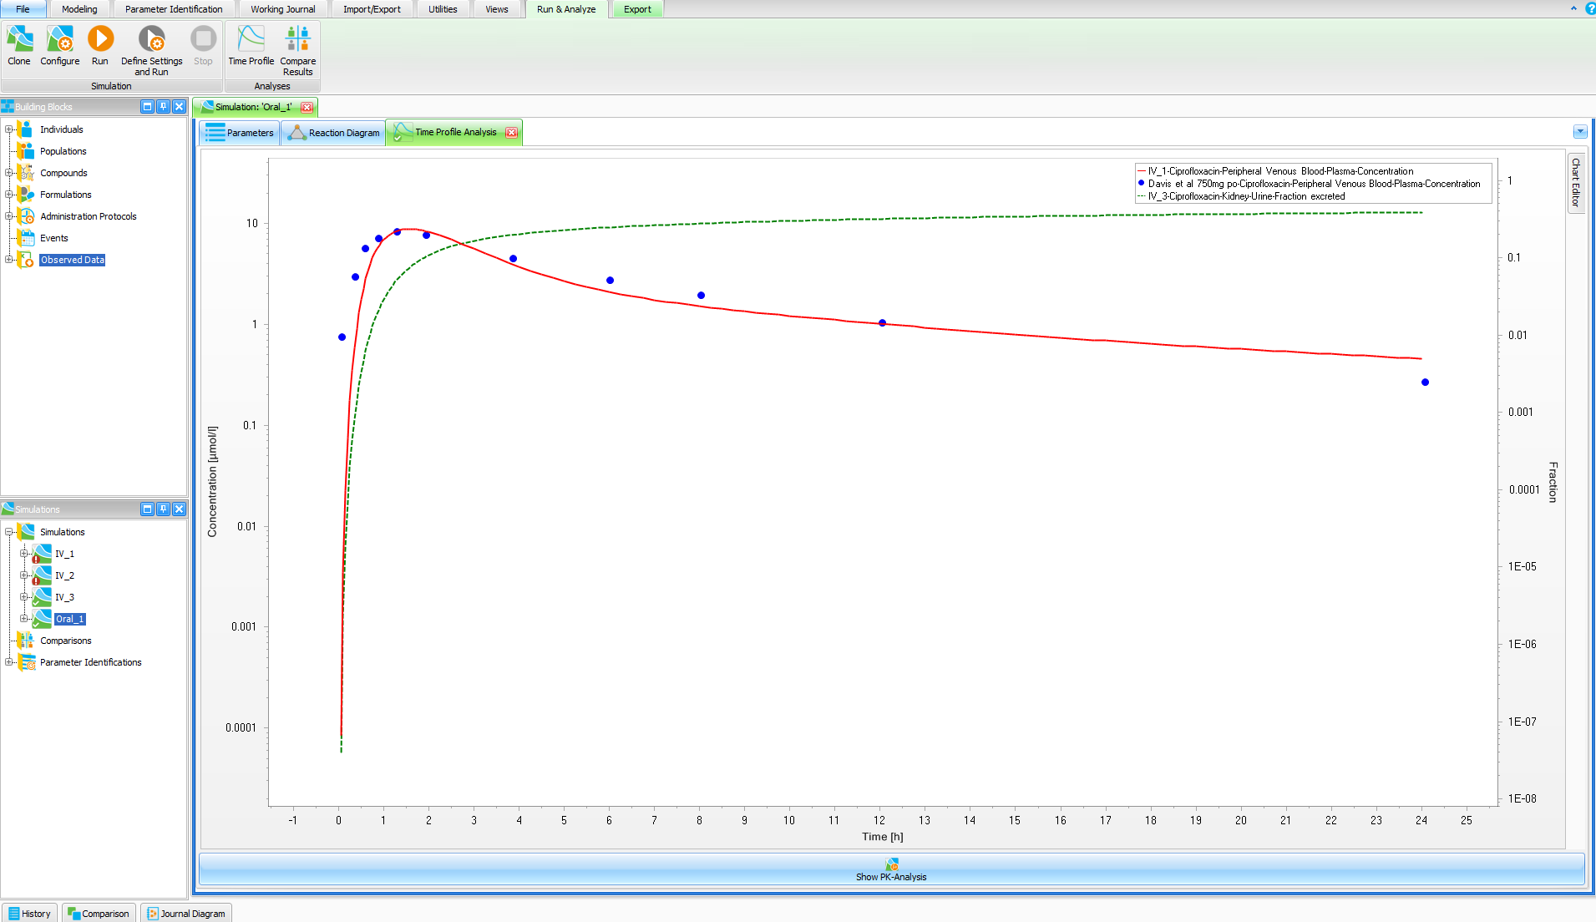
Hands-on Exercise: Build a PBPK model (you can see the end of this exercise in file “PBPK_5.pksim5”)

Slide 40
Hands-on Exercise: Build a PBPK model
Final model structure
Ciprofloxacin
Liver elimination
Renal elimination
CYP1A2 metabolism
Biliary clearance
GFR
Tubular Secretion

Slide 41
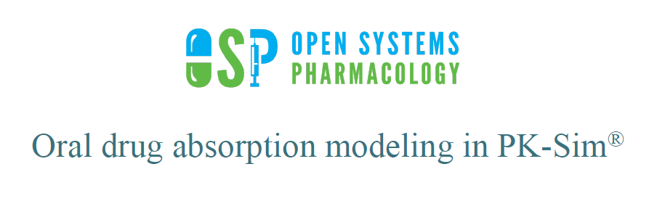

Slide 42
Learning objectives
Detail of the GI absorption model in PK-Sim in terms of
Structure
Physiology
Functionalities for formulation assessments
Explain how to address GI absorption in drug model development using PK-Sim with the purpose of formulation performance assessments

Slide 43
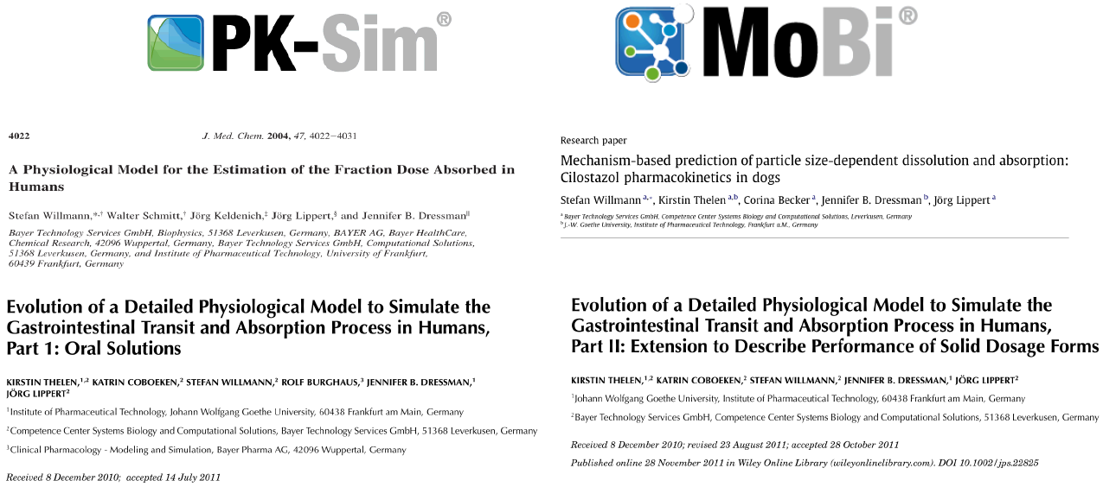
PK-Sim oral absorption model
Where to find information

Slide 44
PK-Sim oral absorption model
Model structure and system parameters
Structure & Pathways, pH, Transit, Volumes, Areas, EHC
Gut metabolism and transporters
Solubility and dissolution
Permeability
Functionalities
Food effects
Formulations
Other

Slide 45
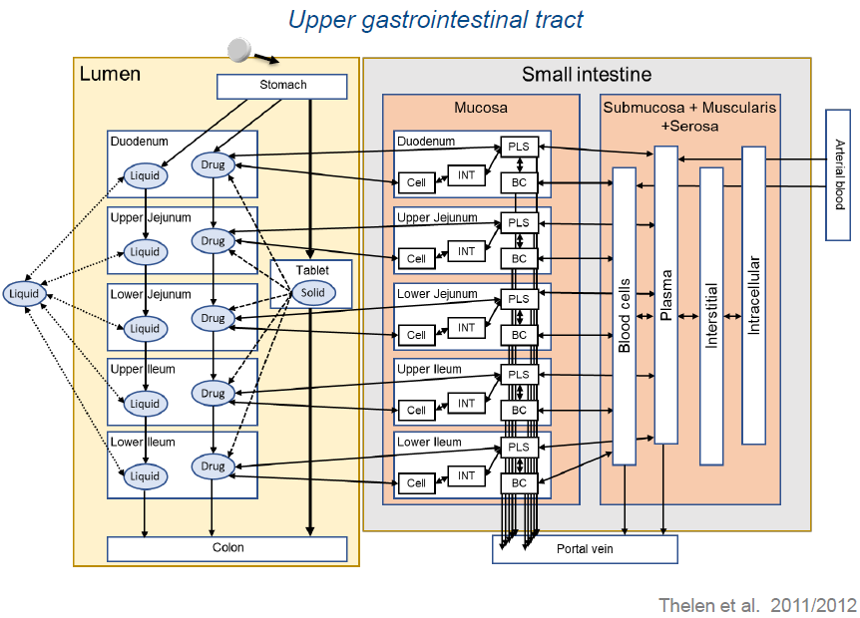
Model structure and system parameters
Structure and pathways
12 compartments representing the lumen of the GI tract from stomach to rectum.
Regional properties (dimensions, surface area, pH, transit times)
Stomach absorption currently not included
… similar structure for large intestine

Slide 46
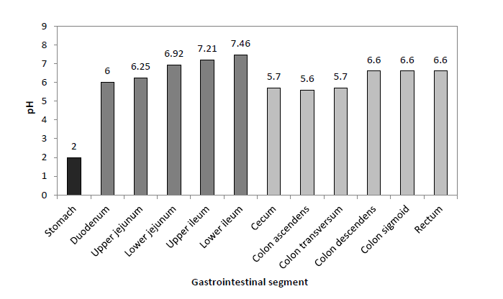
Model structure and system parameters
Luminal pH
Standardized for all typical healthy ID’s
Variability is not included in virtual population creation per default

Slide 47
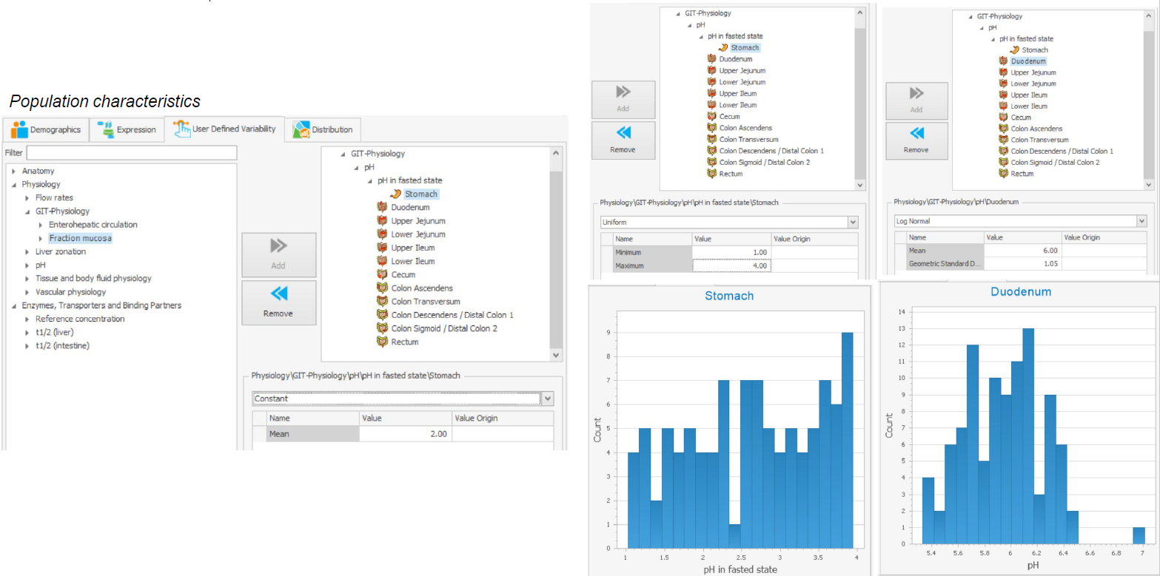
Model structure and system parameters
Define population variability – example luminal pH

Slide 48
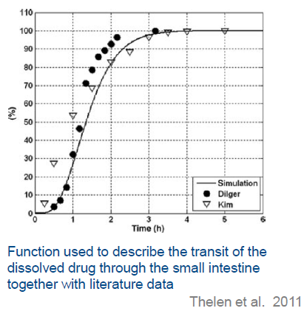
Model structure and system parameters
Transit
Gastric emptying time (fasted state): 15 min
Small intestinal transit time: 2.1 h (complete at ~4h) (time from 63% entered duodenum and 90% has entered caecum)
Large intestinal transit time: 44.2 h (time from 90% entered caecum and 70% excreted into feces)
Total GITT:~48 h → 70% excreted
~120h → 100% excreted
Gastric emptying time and SITT are standardized across age while LITT is age dependent (slight decrease by age).
Variability in gastric emptying time and SITT is included in virtual population creation per default, but not for LITT.

Slide 49
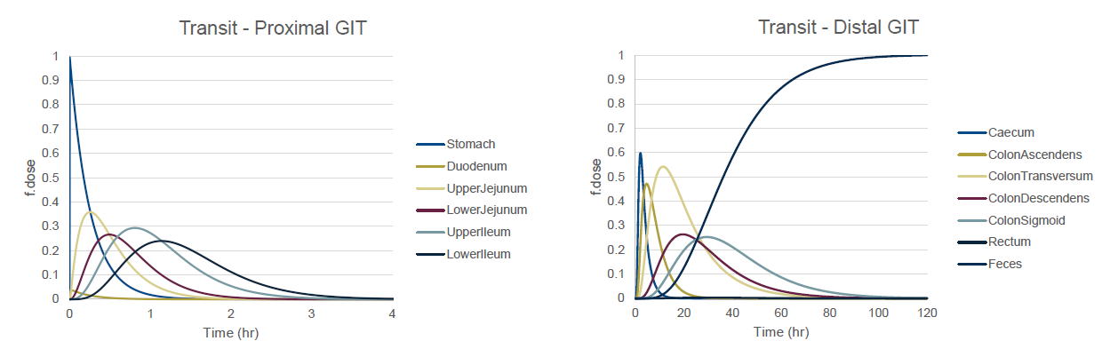
Model structure and system parameters
Transit
Gastric emptying time (fasted state): 15 min
Small intestinal transit time: 2.1 h (complete at ~4h) (time from 63% entered duodenum and 90% has entered caecum)
Large intestinal transit time: 44.2 h (time from 90% entered caecum and 70% excreted into feces)
Total GITT:~48 h → 70% excreted
~120h → 100% excreted

Slide 50
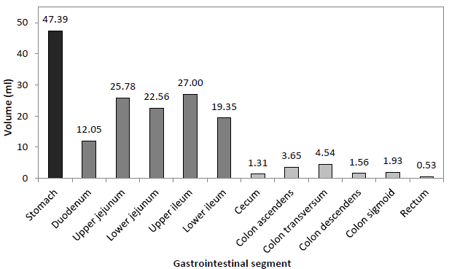
Model structure and system parameters
GI fluid volumes (resting volumes, typical adult ID)
Gastric volume : ~50 ml
Small intestine: ~100 ml
LITT: ~14 ml
Luminal volumes are determined by the size of respective GI segments and a parameter representing the geometric fraction filled (G=0.03, Duo= 0.06, Jej and Ile=0.065, LI=0.006)
Dimensions etc. are shown in PK-Sim per default, however effective luminal volumes are not.
Inter individual variability in luminal volumes are included in virtual population creation per default as an effect of variabilities in organ dimensions and size.

Slide 51
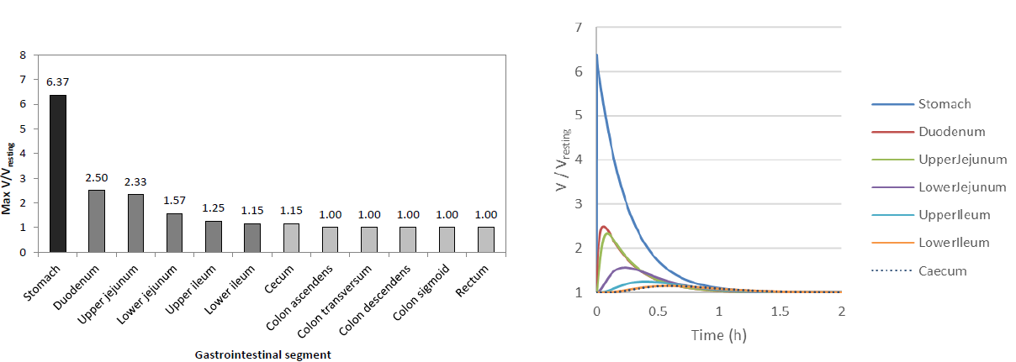
Model structure and system parameters
GI fluid volumes (dynamic volumes)
Volume of co-administered water at oral administration dynamically change luminal volume.
Example using default volume of water taken at oral administration 3.5 ml/BWT →70 kg = ~250 ml

Slide 52
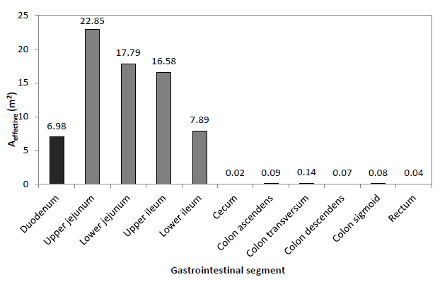
Model structure and system parameters
Epithelial area
Surface in each compartment determined by geometric surface area and an area enhancement factor.
SI area: ~72 m²
LI area: ~0.44 m²
Dimensions etc are shown in PK-Simper default, however effective areas are not.
Area enhancement factors are age dependent (decrease with age).
Interindividual variability in effective areas are included in virtual population creation per default both in terms of variabilities in organ dimensions and size and a global surface area variability parameter.

Slide 53
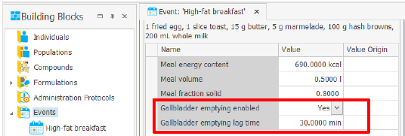
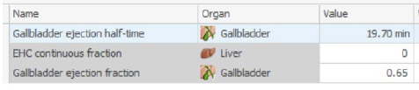
Model structure and system parameters
Enterohepatic circulation Gall bladder emptying is modelled as discrete mass flow from the gallbladder into the duodenum by either
Continuous mass flow (EHC continuous fraction)
Triggered by an event (such as a meal)
Parameters standardized for all typical healthy IDs,
Inter individual variability is not included in virtual population creation per default
Gallbladder emptying does not automatically imply active secretion of the compound into the bile!
In order to enable active secretion into the bile either implement generic biliary excretion or an efflux transport process at the apical side of the liver

Slide 54
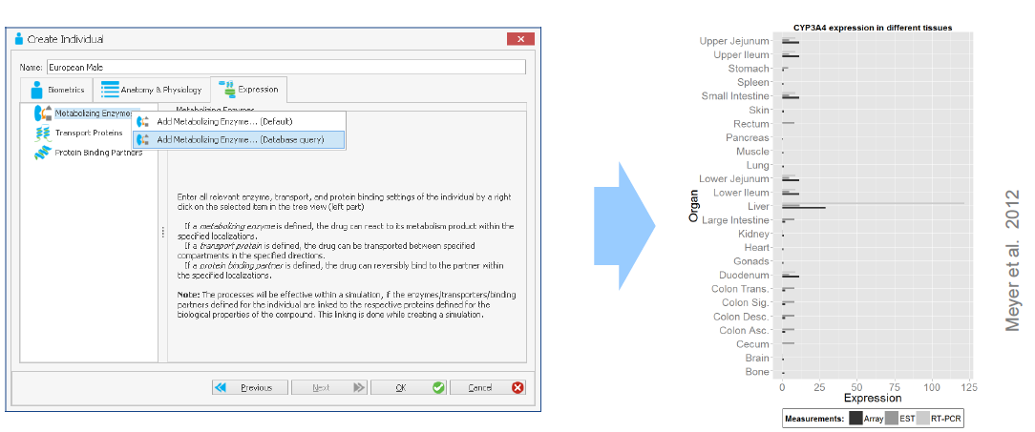
Gut metabolism and transporters
Metabolism can be specified in any of the mucosal intracellular compartments of the intestine
Relative enzyme abundancy along the GI tract can be loaded from the internal gene expression database (Meyer et al. 2012) or defined manually:

Slide 55
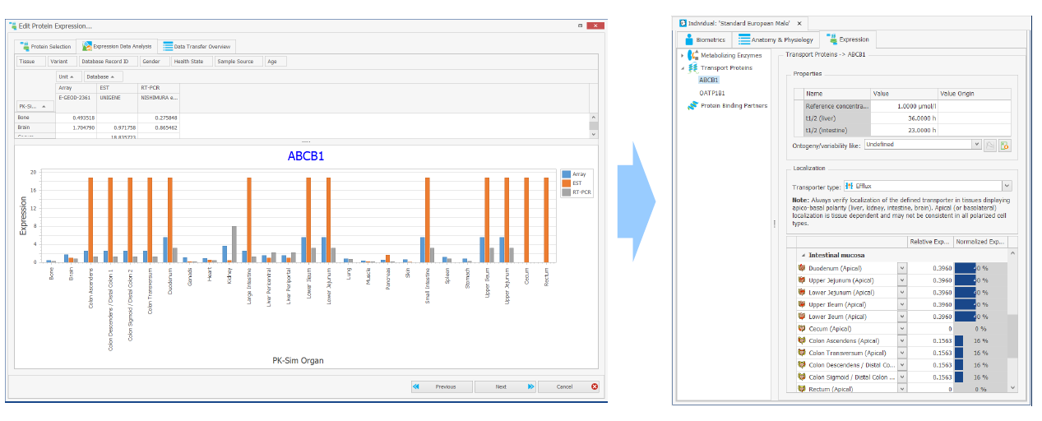
Gut metabolism and transporters
Similarly, to enzymes, drug transporters can also be loaded from the internal gene expression database
Apical or basolateral localization defined

Slide 56
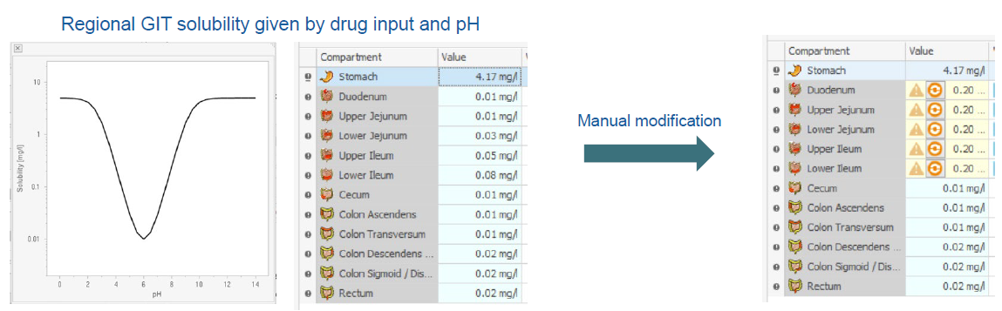
Gut metabolism and transporters
Drug solubility in the GIT is per default defined by the solubility input, ionization and luminal pH
A minimum of one solubility value must be entered to establish a drug BB
Up to three pKa input
Solubility gain per charge
Input option 1: Solubility at reference pH
Input option 2: pH - Solubility table
Regional solubility can manually be modified in simulations

Slide 57
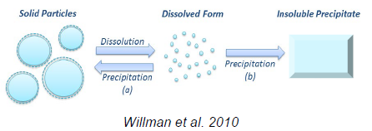
Solubility and dissolution
The Particle dissolution model apply dissolution kinetics of spherical particles with a predefined particle size distribution based on the Noyes-Whitney equation (Willmann et al. 2010).
Drug specific parameters:
How to treat precipitated material (soluble/insoluble)
Aqueous diffusion coefficient
Density of drug material
Threshold for particle radius of immediate dissolution
Allow for supersaturation
Formulation specific parameters:
Thickness of the unstirred water layer (thickness of the diffusion layer)
Type of particle size distribution (either monodisperse or polydisperse),
Particle size distribution for polydisperse particles (normal, log normal) including:
Standard deviation of the particle radius
Number of bins
Minimum and maximum particle radius

Slide 58
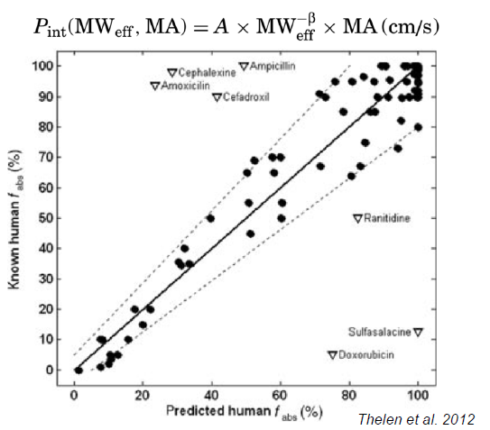
Permeability
Intestinal permeability as input is defined as a function of effective Mw and membrane affinity in relation to the structural model (area and transit).
Relationship estimated to capture observed fraction absorbed.
Not based on in vivo permeability measurements
Default
Transcellular absorption
Unidirectional passive membrane translocation
No pH-effects (charge independent)
No regional differences in permeability

Slide 59
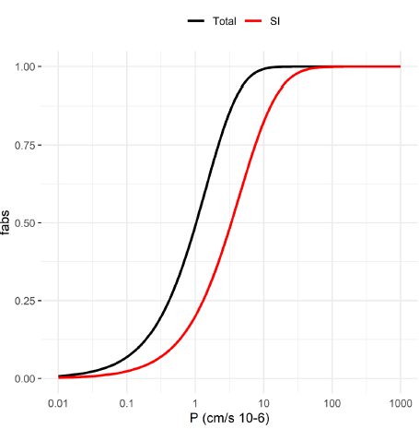
Permeability
Specific intestinal permeability automatically calculated based on Mw and logP
To enable modification to intestinal permeability an additional permeability input needs to be added manually.
Colonic absorption enabled per default

Slide 60
Functionalities –Food effects
Food intake can be defined in the Event Building Block section:
Meal energy, meal volume and the solid fraction of the meal are predefined for several food types
Relevant parameters of the food can also be manually modified by the user
Food intake triggers the following physiological changes in the GI tract (Thelen et al. 2012, Willmann et al. 2014):
Initial liquid volume in stomach is increased by food volume
Gastric pH is increased and then decays exponentially
Gastric emptying time is slowed based on an empirical function fitted to >100 experimental gastric emptying profiles observed in healthy adults
Optionally: Gallbladder emptying

Slide 61
Functionalities –Formulations
Predefined options to define a formulation/drug release function in the Building Block section:
Dissolved: Drug is administered in solution
Zero order release: Empirical function assuming zero order release kinetics
First order release: Empirical function assuming first order release kinetics
Lint80 release: Empirical function assuming linear release until 80% of the administered dose is dissolved
Weibull: Empirical function for drug dissolution with high flexibility
Table read-in: Import of user-defined dissolution/release data
Particle dissolution: Monodisperse or polydisperse particle distribution (up to 20 bins)

Slide 62
Functionalities –Other
GET of non-disintegrated moiety
Time point at which a Single unit system leaves the stomach and enters duodenum
Bi-directional flow over the epithelial
Activate possibility for passive secretion from system to lumen
Bioavailability
The bioavailability is only calculated on request. A second simulation with an i.v. short infusion is carried out using identical parameters. The bioavailability is then calculated from AUCinf (p.o.)/AUCinf (i.v.) in the venous blood compartment. May be necessary to simulate as long as the total gastrointestinal transit takes (120 h).
Fraction excreted in feces
For oral administrations, fraction excreted in feces enables an additional assessment of the absorption process

Slide 63
Session 2 -Hands on Part 1 – Establish oral absorption model
Task: Establish oral absorption model for “Drug” using data after oral solution administration as reference.
Systemic disposition already established.
Information of relevance for oral absorption model development
Internal data (not shown) suggests
Incomplete absorption
Gut wall metabolism in small intestine
Negligible absorption in colon (colon ascendens-rectum)
If time allows: Investigate transporters and EHC. Reflect on potential impact on systemic disposition

Slide 64
Session 2 -Hands on Part 2 – Formulation performance in virtual populations
Task: Evaluate formulation performance in virtual population with established model.
Create a representative trial population (Age, BWT, and HT) Optional: Add variability in metabolism (liver and/or intestine)
Perform virtual trial simulations for Reference and Test formulations (n=3).
Run simulations
Assess output visually.
If time allows: Evaluate impact of population variability on AUC and Cmax.
After intra venous administration
After oral administration

